Slide 1


Slide 2
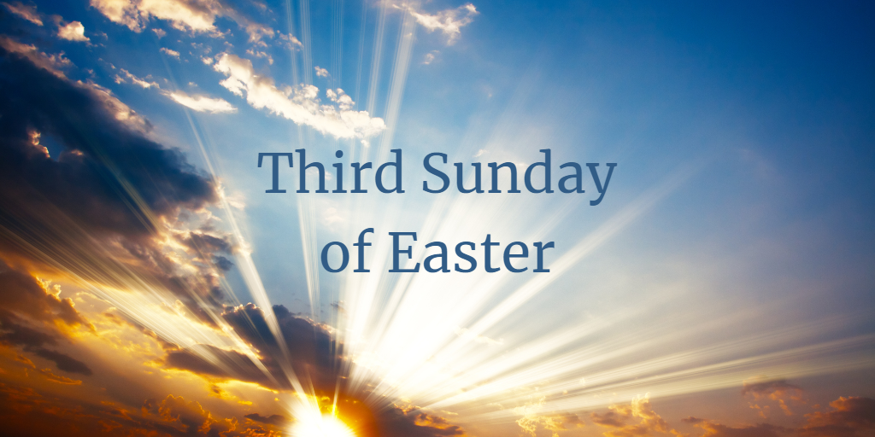

Slide 4
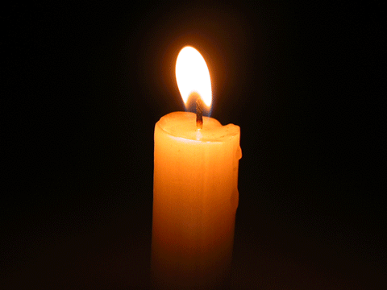
Lighting the Christ candle

Slide 6
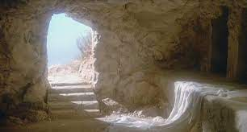
The Lord be with you
And also with you

Slide 7

Let us
pass the peace

Slide 9
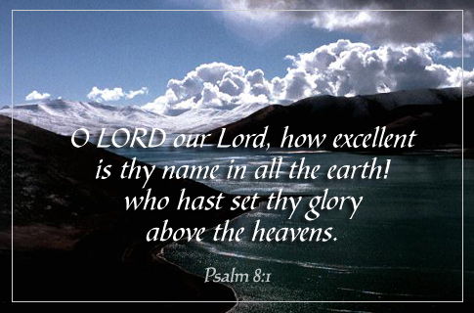

Slide 10
1 O LORD, our Lord,
how majestic is Your name
in all the earth!
You have set Your glory
above the heavens.
2 From the lips of children and infants
You have ordained praise
because of Your enemies,
to silence the foe and the avenger.

Slide 11
3 When I consider your heavens,
the work of Your fingers,
the moon and the stars,
which You have set in place,
4 what is mankind that
You are mindful of me,
the son of man that You care for me?

Slide 12
5 You made Him a little lower
than the heavenly beings
and crowned Him
with glory and honour.
6 You made Him ruler
over the works of Your hands;
You put everything under His feet!

Slide 13
7 all flocks and herds,
and the beasts of the field,
8 the birds of the air,
and the fish of the sea,
all that swim the paths of the seas

Slide 14
9 O LORD, our Lord,
how majestic is Your name
in all the earth!
Amen!

Slide 16
Awake, my soul, and with the sun
Your daily stage of duty run;
Shake off your sleep
And joyful rise
To pay our morning sacrifice.
1/5

Slide 17
Glory to You who keep me safe
And has refreshed me while I slept
Grant, Lord, when I from death shall
Wake I may of endless light partake.
2/5

Slide 18
Lord, I my vows to You renew;
Disperse my sins as morning dew;
Guard my first springs
of thought and will,
And with Yourself my spirit fill.
3/5

Slide 19
Direct, control, suggest, this day
All I design or do or say,
That all my powers,
with all their might,
In your sole glory may unite.
4/5

Slide 20
Praise God, from whom all blessings flow,
Praise him, all creatures here below,
Praise Him above ye heavenly host,
Praise Father, Son and Holy Ghost.
5/5

Slide 22


Slide 23
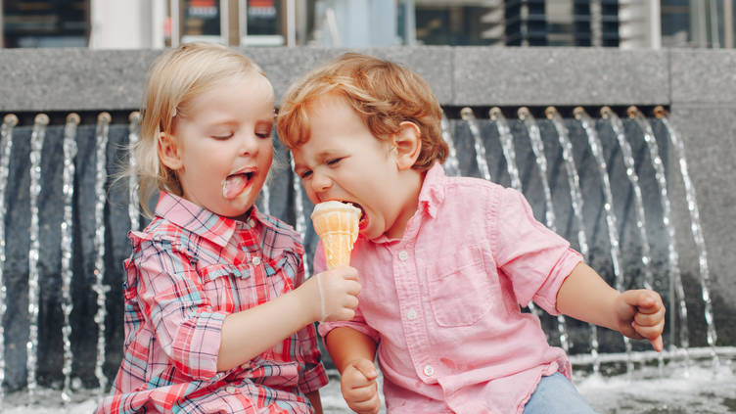

Slide 24
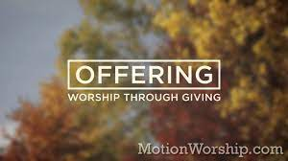

Slide 26


Slide 27
¹² When Peter saw this, he said to them:
“Fellow Israelites, why does this surprise you?
Why do you stare at us as if by our own power or godliness we had made this man walk?
¹³ The God of Abraham, Isaac and Jacob,
the God of our fathers, has glorified his servant Jesus. You handed him over to be killed, and you disowned him before Pilate, though he had decided to let him go.
¹⁴ You disowned the Holy and Righteous One and asked that a murderer be released to you.

Slide 28
¹⁵ You killed the author of life, but God raised him from the dead. We are witnesses of this.
¹⁶ By faith in the name of Jesus, this man whom you see and know was made strong. It is Jesus’ name and the faith that comes through him that has completely healed him, as you can all see.
¹⁷ “Now, fellow Israelites, I know that you acted in ignorance, as did your leaders.

Slide 29
¹⁸ But this is how God fulfilled what he had foretold through all the prophets, saying that his Messiah would suffer.
¹⁹ Repent, then, and turn to God, so that your sins may be wiped out, that times of refreshing may come from the Lord,

Slide 30
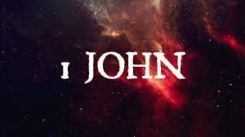

Slide 31
See what great love the Father has lavished on us, that we should be called children of God!
And that is what we are! The reason the world does not know us is that it did not know him.
² Dear friends, now we are children of God,
and what we will be has not yet been made known. But we know that when Christ appears,
we shall be like him, for we shall see him as he is.
³ All who have this hope in him purify themselves, just as he is pure.

Slide 32
⁴ Everyone who sins breaks the law;
in fact, sin is lawlessness.
⁵ But you know that he appeared so that he might take away our sins. And in him is no sin.
⁶ No one who lives in him keeps on sinning. No one who continues to sin has either seen him or known him.
⁷ Dear children, do not let anyone lead you astray. The one who does what is right is righteous, just as he is righteous.

Slide 34
Eternal Father, strong to save,
Whose arm has bound the restless wave,
Who bids the mighty ocean deep
Its own appointed limits keep;
Oh, hear us when we cry to Thee,
For those in peril on the sea!
1/4

Slide 35
O Christ! Whose voice the waters heard
And hushed their raging at Thy Word
Who walkest on the foaming deep,
And calm amid the storm didst keep;
O, hear us when we cry to Thee,
For those in peril on the sea!
2/4

Slide 36
O Holy Spirit! Who didst brood
Upon the waters dark and rude,
And bid its angry tumult cease,
And give, for wild confusion, peace;
Oh, hear us when we cry to Thee,
For those in peril on the sea!
3/4

Slide 37
O Trinity of love and power!
Our people shield in danger’s hour;
From rock and tempest, fire and foe,
Guard them wherever they may go;
Thus evermore shall rise to Thee
Glad hymns of praise from land and sea.
4/4
William Whiting 1825-78

Slide 39
This is a pastoral letter to churches in conflict––written to address the conflict and to prevent its spread.
A number of scholars think of this as a sermon in written form.
The problems in the churches were caused by false teachers who had left the church (2:19).
These false teachers denied the Incarnation and the deity of Jesus and claimed not to be sinners. They may have been precursors of the Gnostic heretics who plagued the second century church.

Slide 40
See what great love the Father has lavished on us, beyond extravagant, that we should be called children, adopted by the king, not by birth but rebirth, born again or is it being deeply aware of God, of God!
And that is what we are! the story of the mother of two children––one natural born and the other adopted. When someone asked, “Which child is adopted?” the mother gazed for a moment into the distance and then answered, “I can’t remember.”
The reason the world does not know us is that it did not know him. I’d like to turn that around, as we know Him, the world will know Him.

Slide 41
² Dear friends, now! we are children of God!, and what we will be has NOT YET been made known, as Paul would say about a mirror dimly, and be assured that what is prepared is beyond anything we hope or desired.

Slide 42
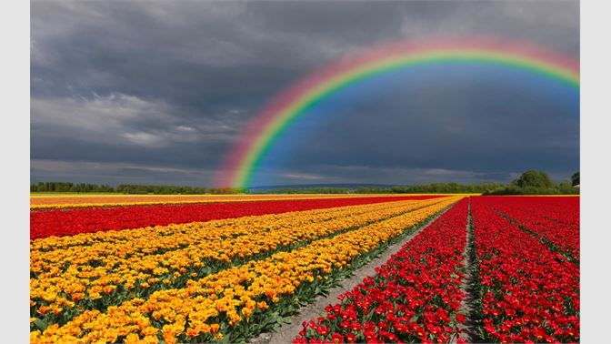

Slide 43
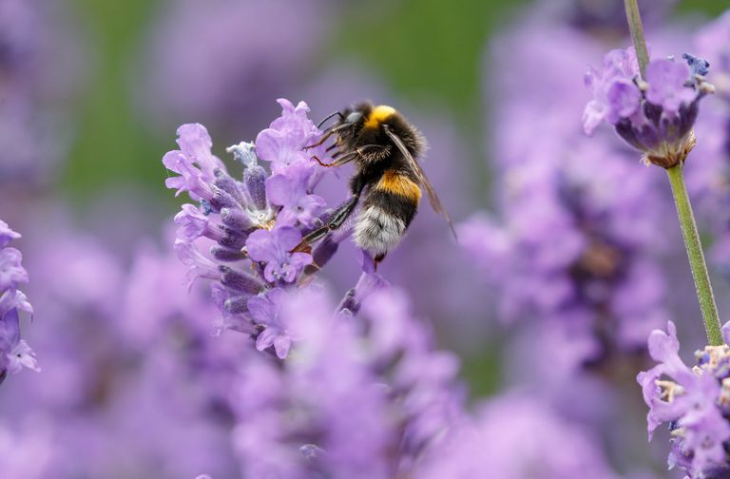

Slide 44
But we know that when Christ appears, we shall be like him, transfigured ??, for we shall see him as he is. Transfigured.
³ All who have this hope in him purify themselves, just as he is pure.

Slide 45
⁴ Everyone who sins breaks the law, as the Jews regard the law, so should we.; in fact, sin is lawlessness.
⁵ But you know that he appeared so that he might take away our sins. And in him is no sin.

Slide 46
⁶ No one who lives in him keeps on sinning.
No one who continues to sin has either seen him or known him.
⁷ Dear children, do not let anyone lead you astray, always check what they are saying, clarify. The one who does what is right is righteous, just as he is righteous.

Slide 48
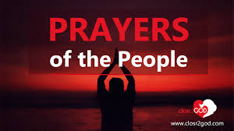

Slide 50
Our Father in heaven,
hallowed be Your name,
Your kingdom come,
Your will be done
On earth as in heaven.
Give us today our daily bread.

Slide 51
And forgive us our sins,
As we forgive those
who sin against us.
Save us from the time of trial,
And deliver us from evil.
For the kingdom, the power
and the glory are Yours,
Now and forever. Amen.

Slide 53
O for a thousand tongues to sing
My great Redeemer’s praise
My great Redeemer’s praise
The glories of our God and King
The triumphs of His grace!
The triumphs of His grace!
The triumphs of His grace!

Slide 54
Jesus! The name That charms our fears
That bids our sorrows cease;
That bids our sorrows cease;
‘Tis music in the sinner’s ear,
‘Tis life and health and peace.
‘Tis life and health and peace.
‘Tis life and health and peace.

Slide 55
He breaks the power of cancelled sin
He sets the prisoner free;
He sets the prisoner free;
His blood can make the foulest clean
His blood availed for me.
His blood availed for me.
His blood availed for me.

Slide 56
He speaks, and listening to His voice
New life the dead receive,
New life the dead receive,
The mournful, broken hearts rejoice
The humble poor believe.
The humble poor believe.
The humble poor believe.

Slide 57
Hear Him, ye deaf; His praise, ye dumb,
Your loosened tongues employ
Your loosened tongues employ
Ye blind, behold Your Saviour come;
And leap ye lame, for joy!
And leap ye lame, for joy!
And leap ye lame, for joy!

Slide 58
My gracious Master and my God,
Assist me to proclaim,
Assist me to proclaim,
To spread through all the earth abroad
The honours of Your name.
The honours of Your name.
The honours of Your name
Charles Wesley 1707—88

Slide 60


Slide 61


